Slide 1



Figure 1
Metamonada
Opisthokonta
Amoebozoa
Discoba
Rhizaria
Streptophyta
Alveolata
Stramenopila
Rhodophyta
Chlorophyta

Slide 2

Figure 1

Slide 3







Figure 2

Slide 4










Figure 3
1
1694
RICTORN
RICTORM
RasGEF
Domain5
RICTOR Phosphorylation
ARM Repeats
1
1353
RAPTORN
ARM Repeats
HEAT
ARM Repeats
WD-40 Repeats

Slide 5



Figure 4

Slide 6
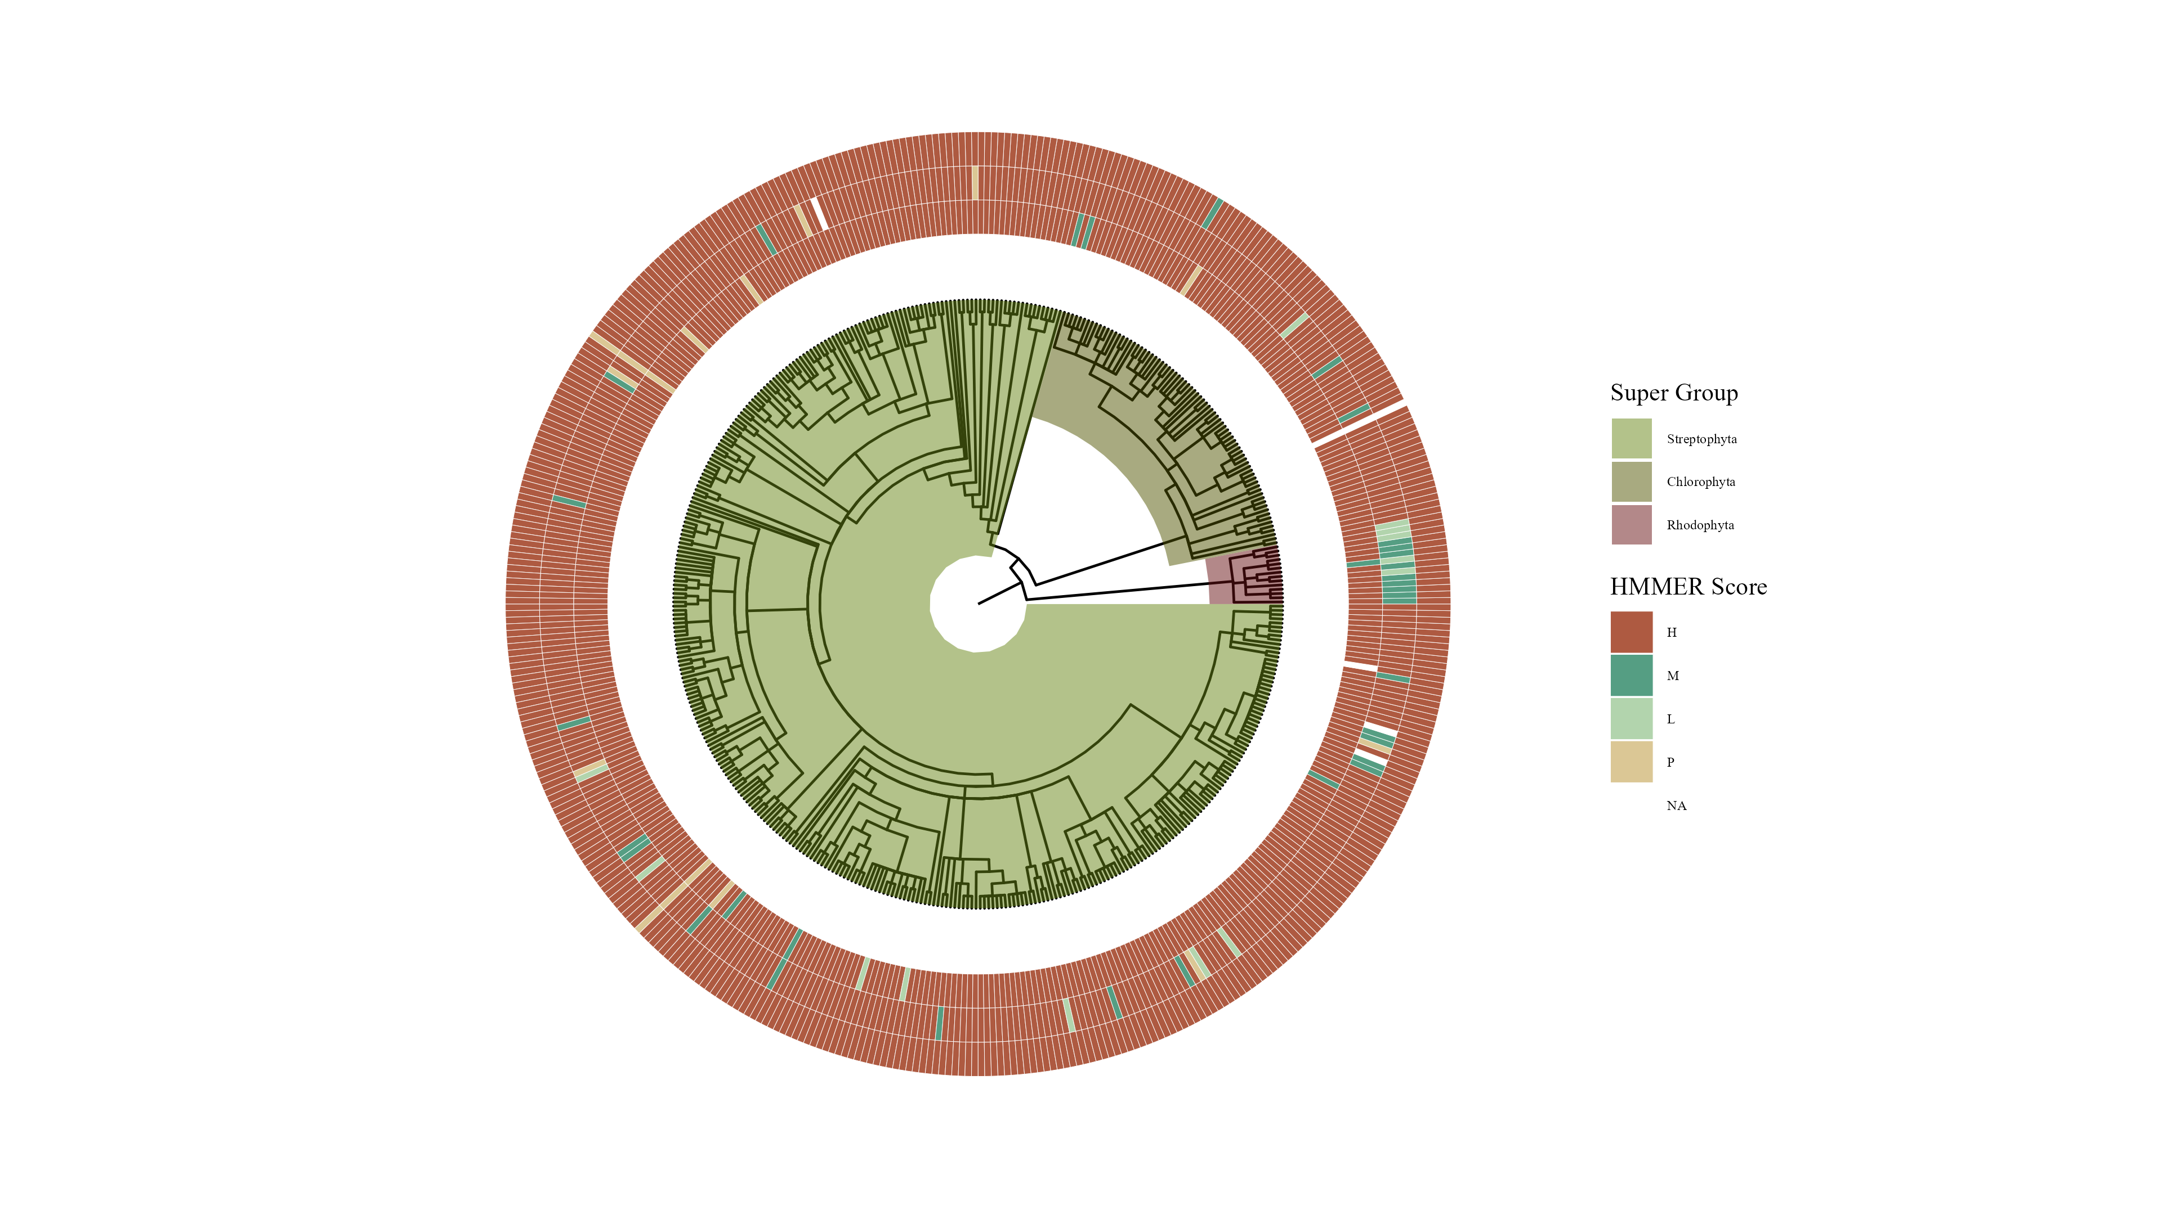

Slide 7

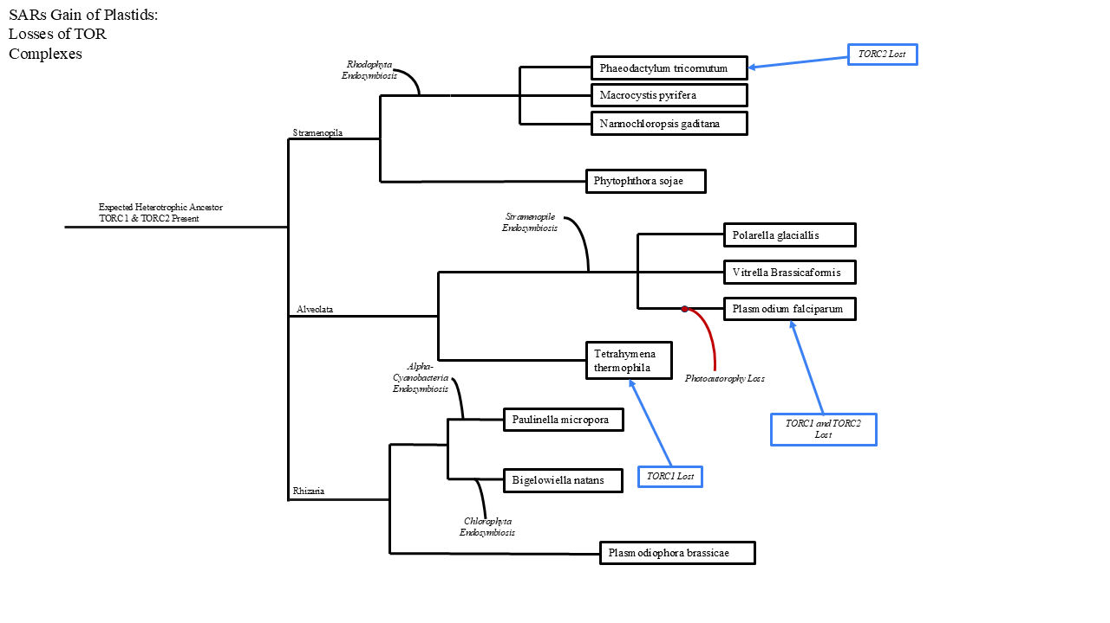



Figure 6

Slide 8

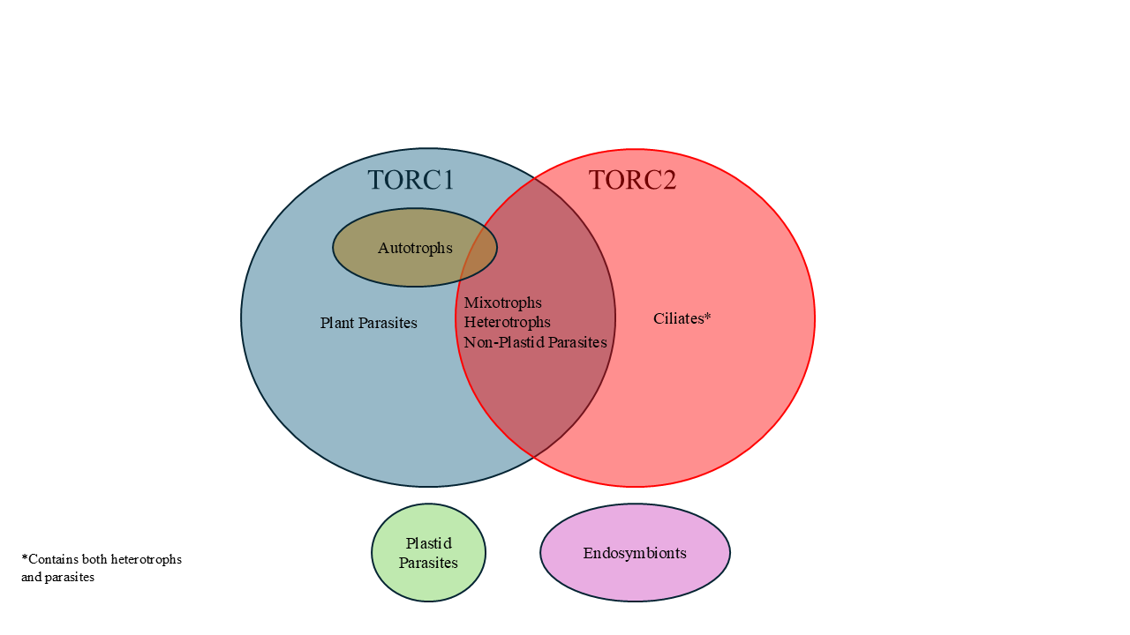


Figure 5

Slide 9


Figure 7

Slide 10
Workflow/Pipeline
NCBI/JGI Genomic Information
MSA
Phylogenetic Tree(s)
Results/TOR Complex Patterns
BUSCO/HMMER/BLAST
R Tables & Taxonomy Tables
Graphs/Data Table
SRA /Diamond Alignment
Notes:
We need to add a start point. Have something that asks the question; what organisms have TORC2 Components and TORC1 Components?

Slide 11
SARs Gain of Plastids:
Losses of TOR Complexes
Rhodophyta Endosymbiosis
Phaeodactylum tricornutum
TORC2 Lost
Macrocystis pyrifera
Stramenopila
Nannochloropsis gaditana
Phytophthora sojae
Expected Heterotrophic Ancestor
TORC1 & TORC2 Present
Stramenopile Endosymbiosis
Polarella glaciallis
Vitrella Brassicaformis
Alveolata
Plasmodium falciparum
Tetrahymena thermophila
Alpha-Cyanobacteria Endosymbiosis
Photoautorophy Loss
Paulinella micropora
TORC1 and TORC2 Lost
Bigelowiella natans
TORC1 Lost
Rhizaria
Chlorophyta Endosymbiosis
Plasmodiophora brassicae

Slide 12
Simplified Excavata Gain of Plastids
Chlorophyta Endosymbiosis
Euglenophyceae
Discoba
Kinetoplastea
Eutetramitia, etc.
Expected Heterotrophic Ancestor
TORC1 & TORC2 Present
Metamonada

Slide 13
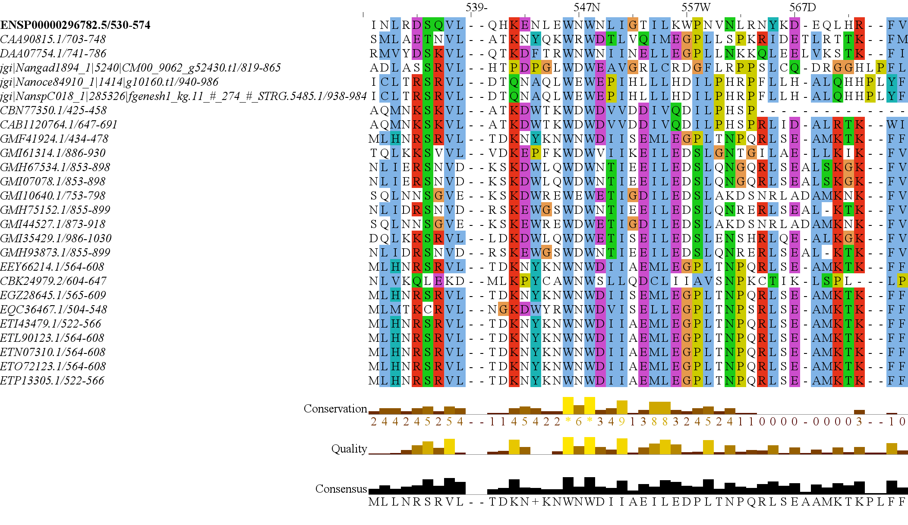
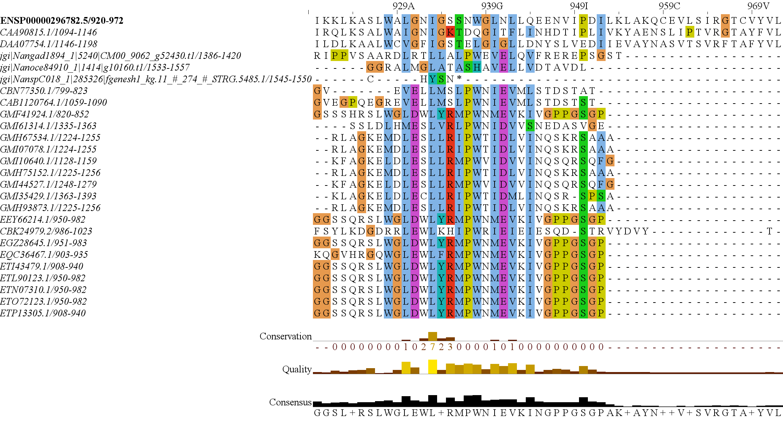
RICTORN
RICTORM
RasGEF
Domain5
RICTOR Phosphorylation
ARM Repeats

Slide 14
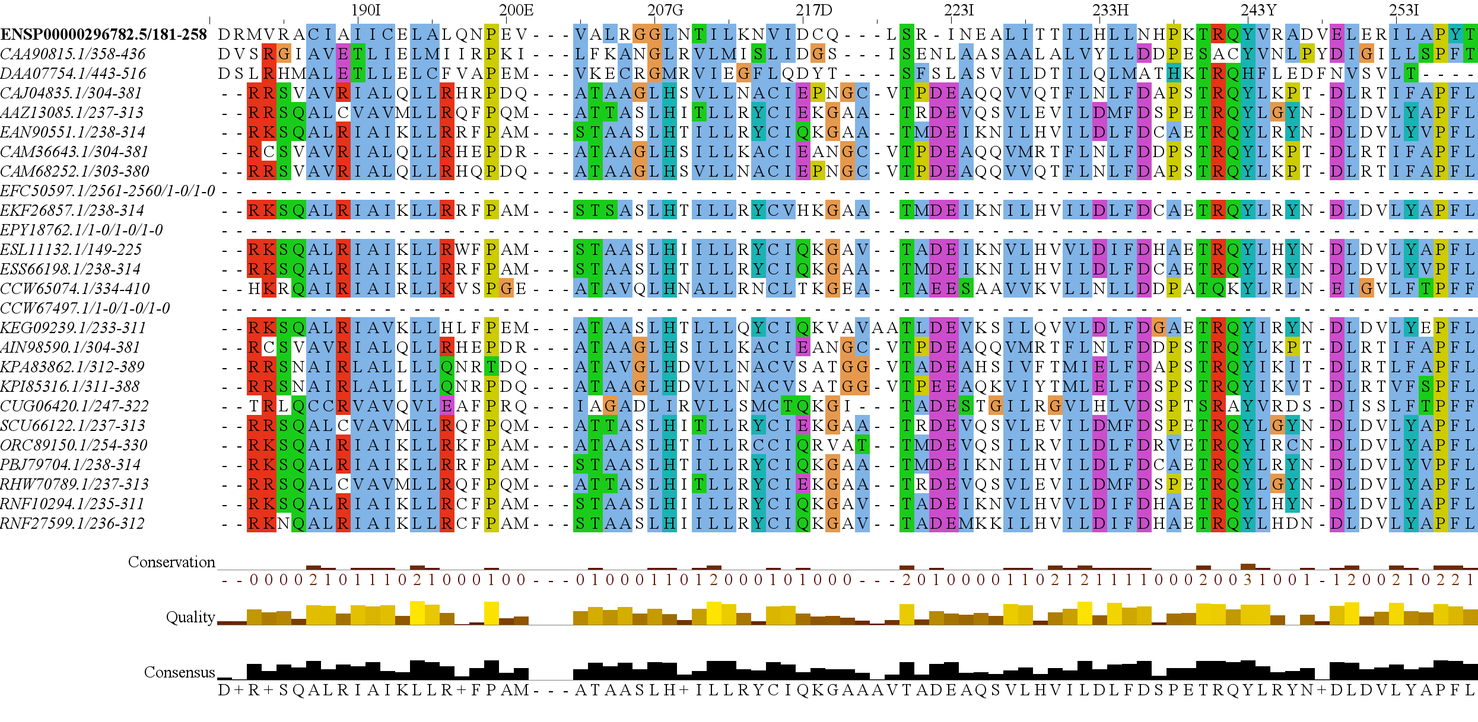
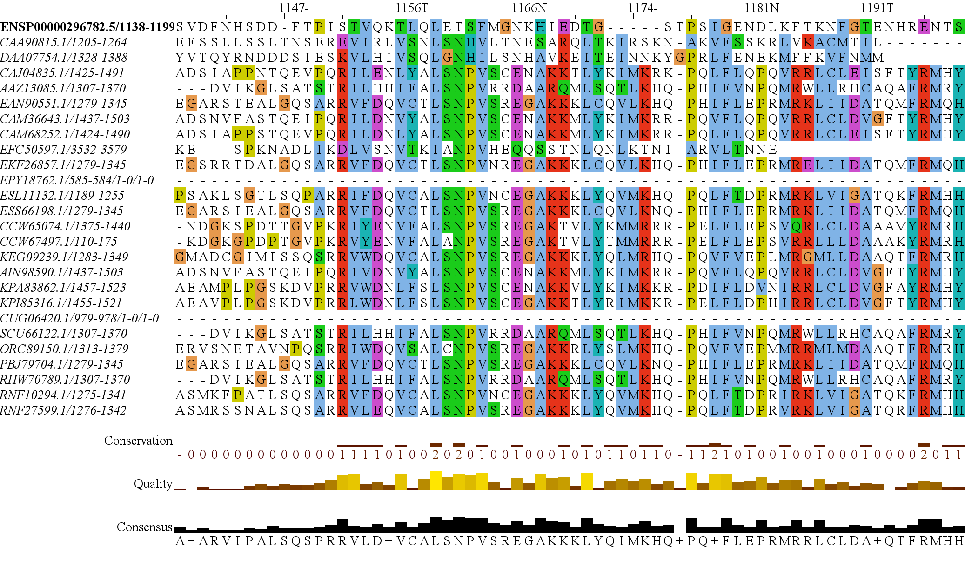
RICTORN
RICTORM
RasGEF
Domain5
RICTOR Phosphorylation
ARM Repeats

Slide 15
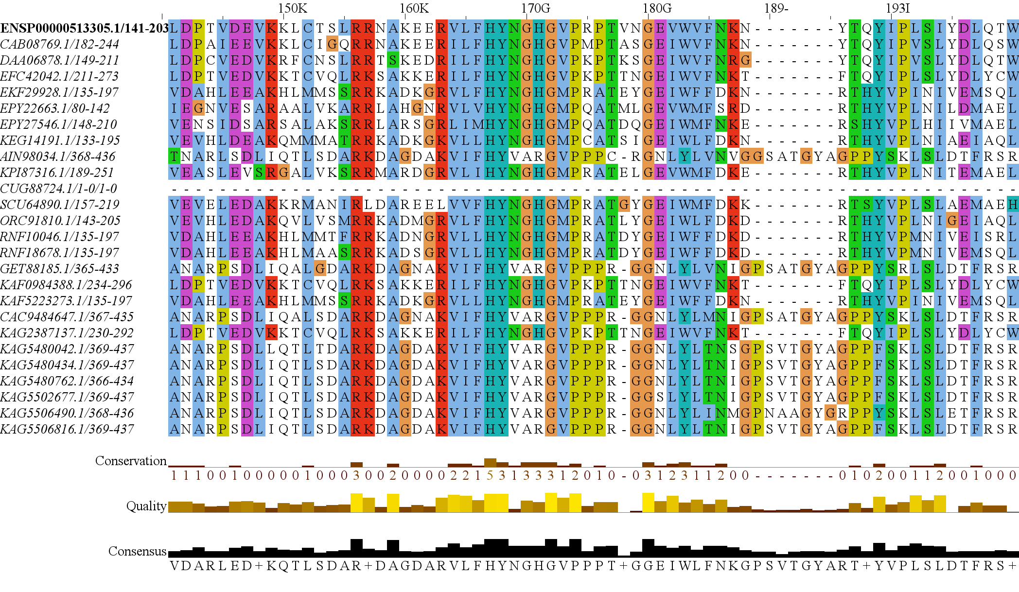
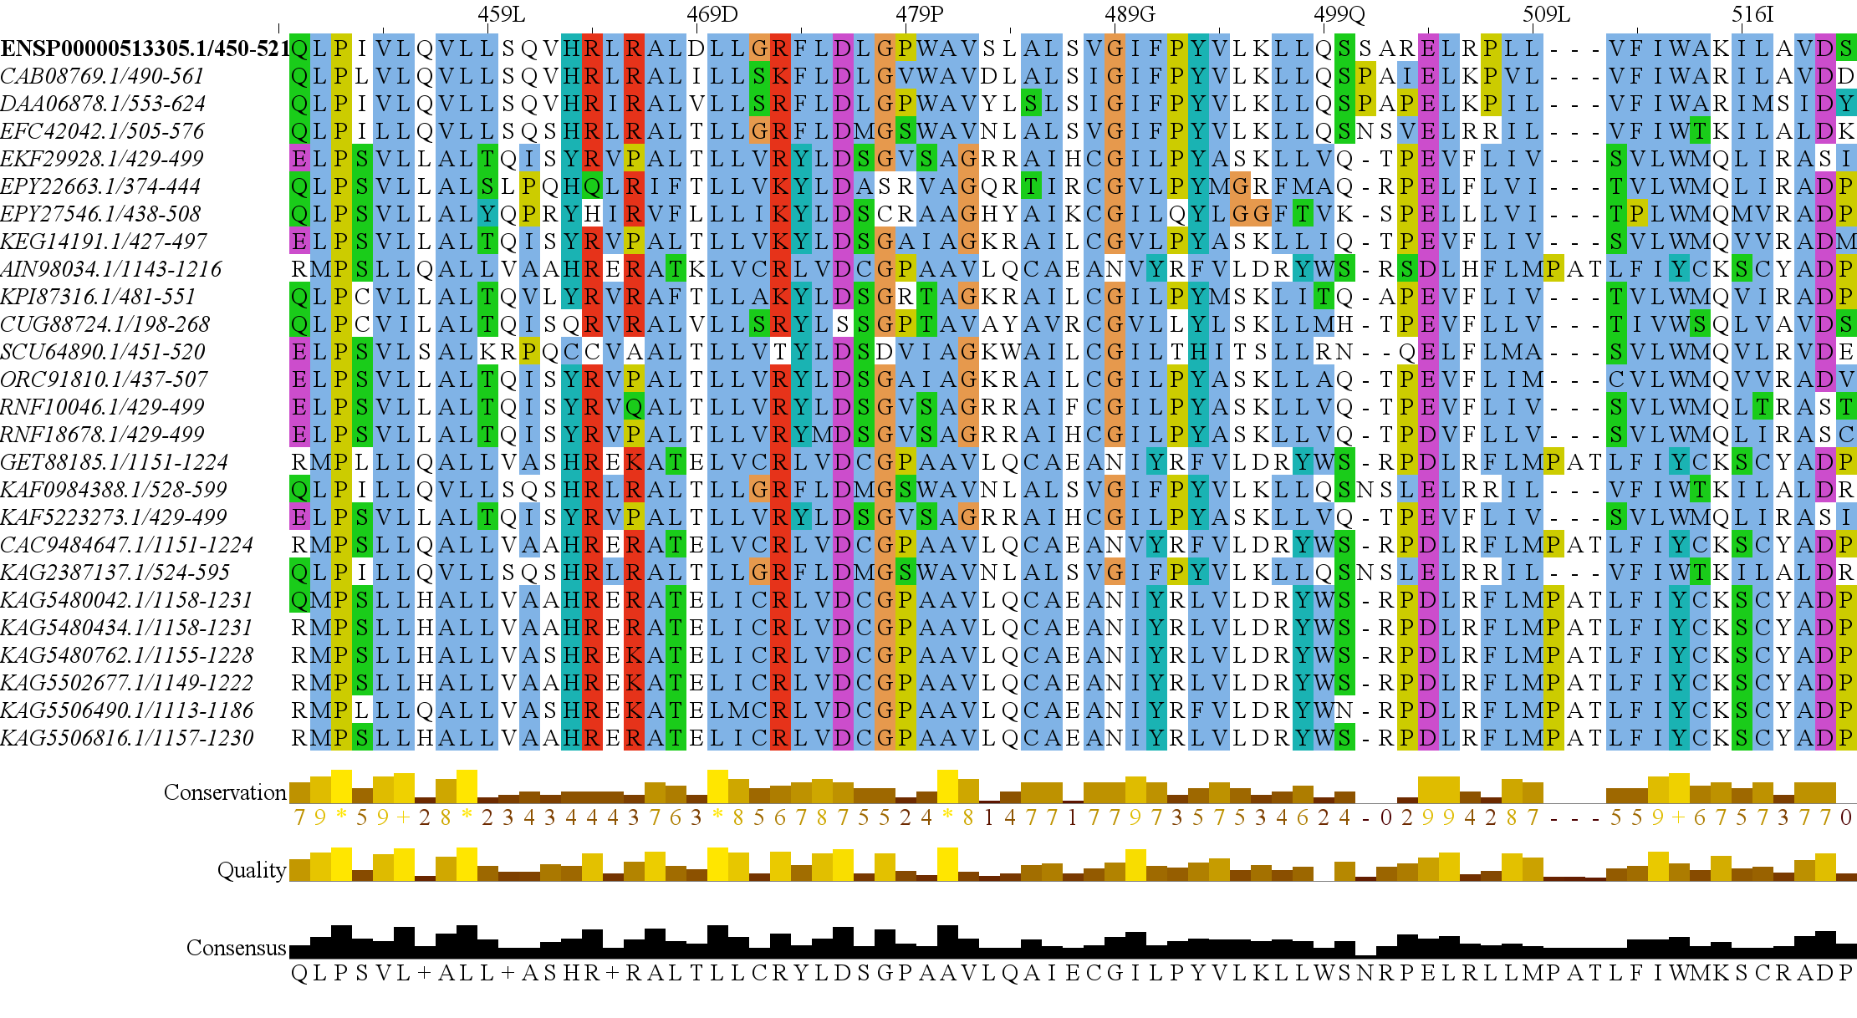
RAPTORN
ARM Repeats
HEAT
ARM Repeats
WD-40 Repeats

Slide 16
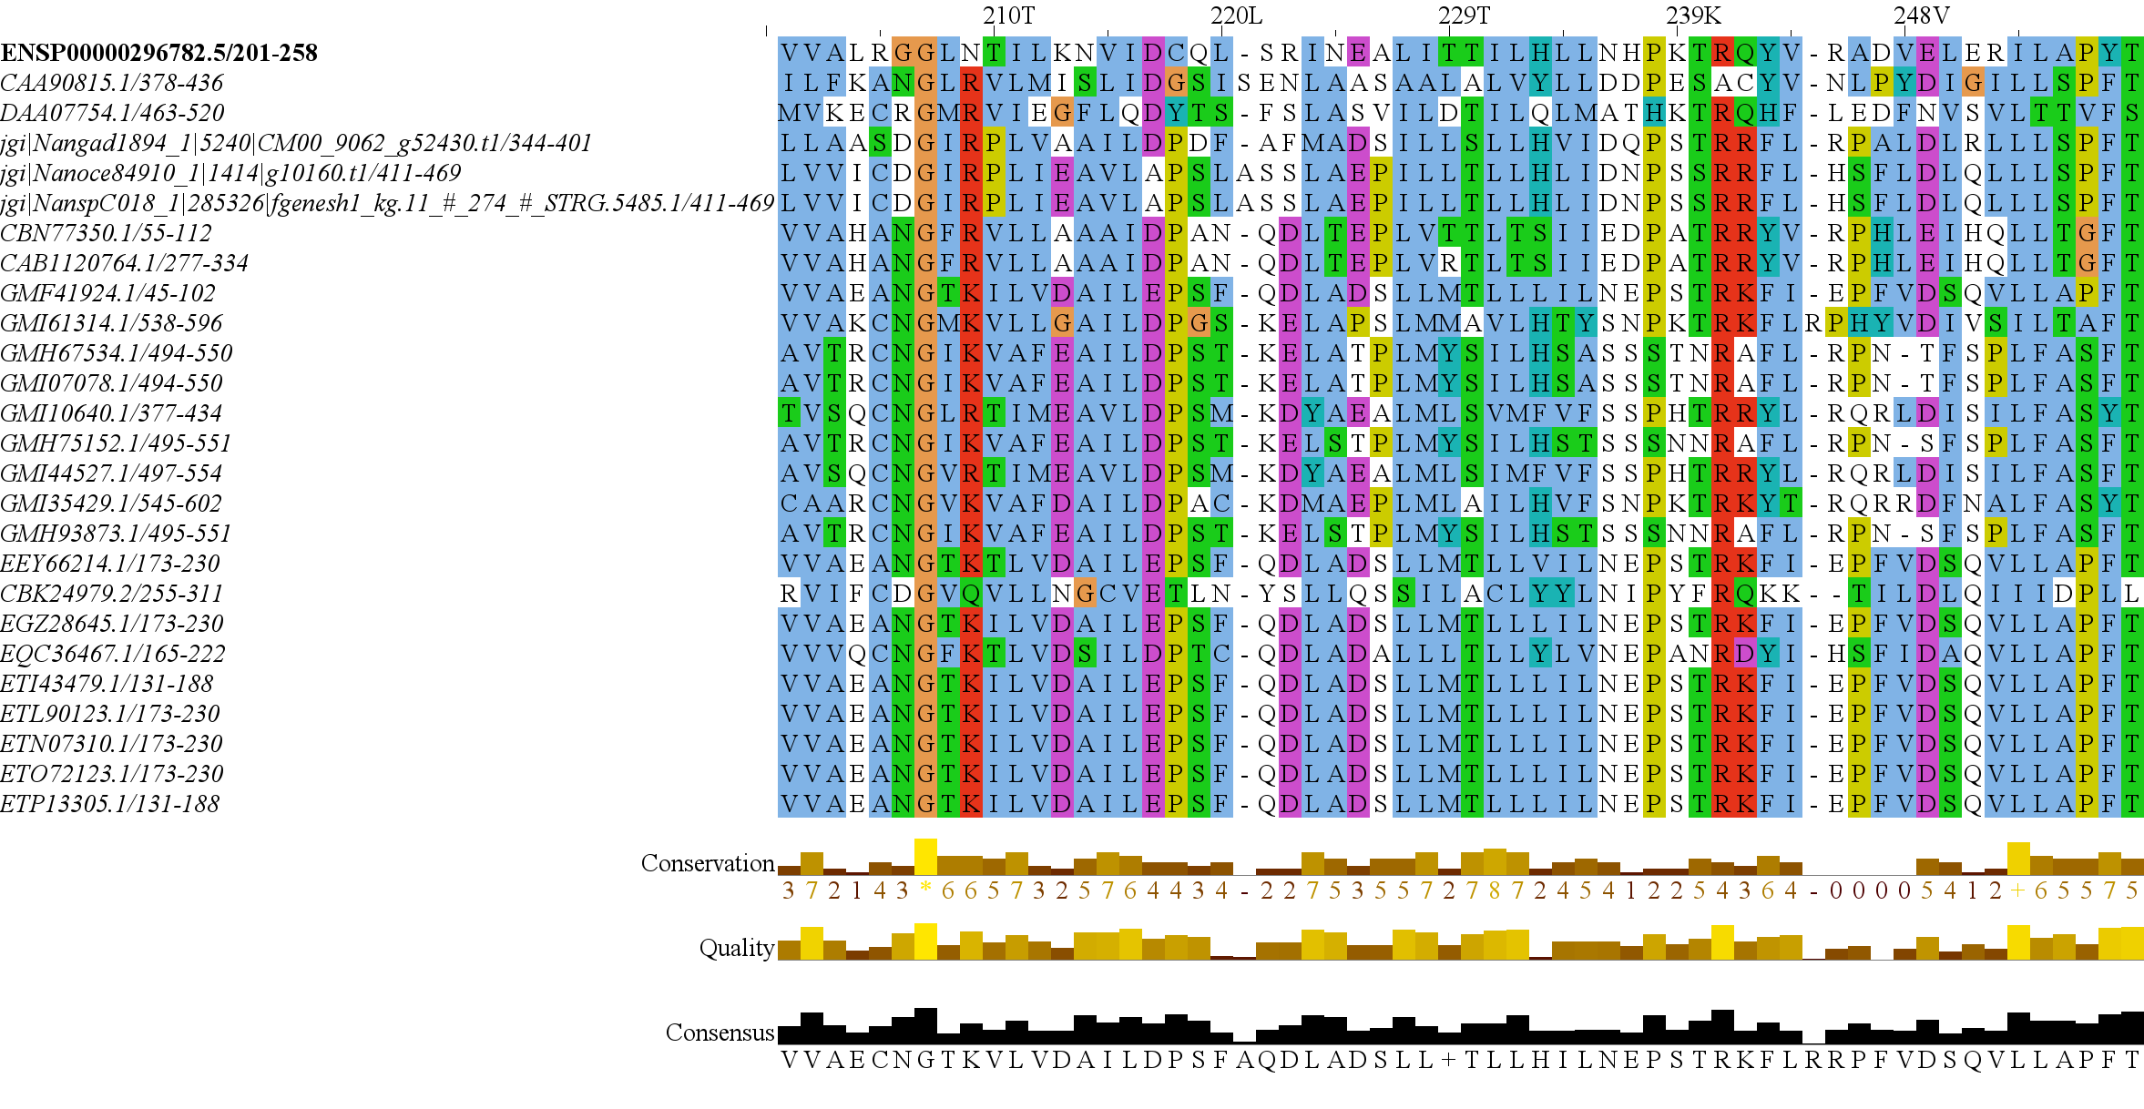
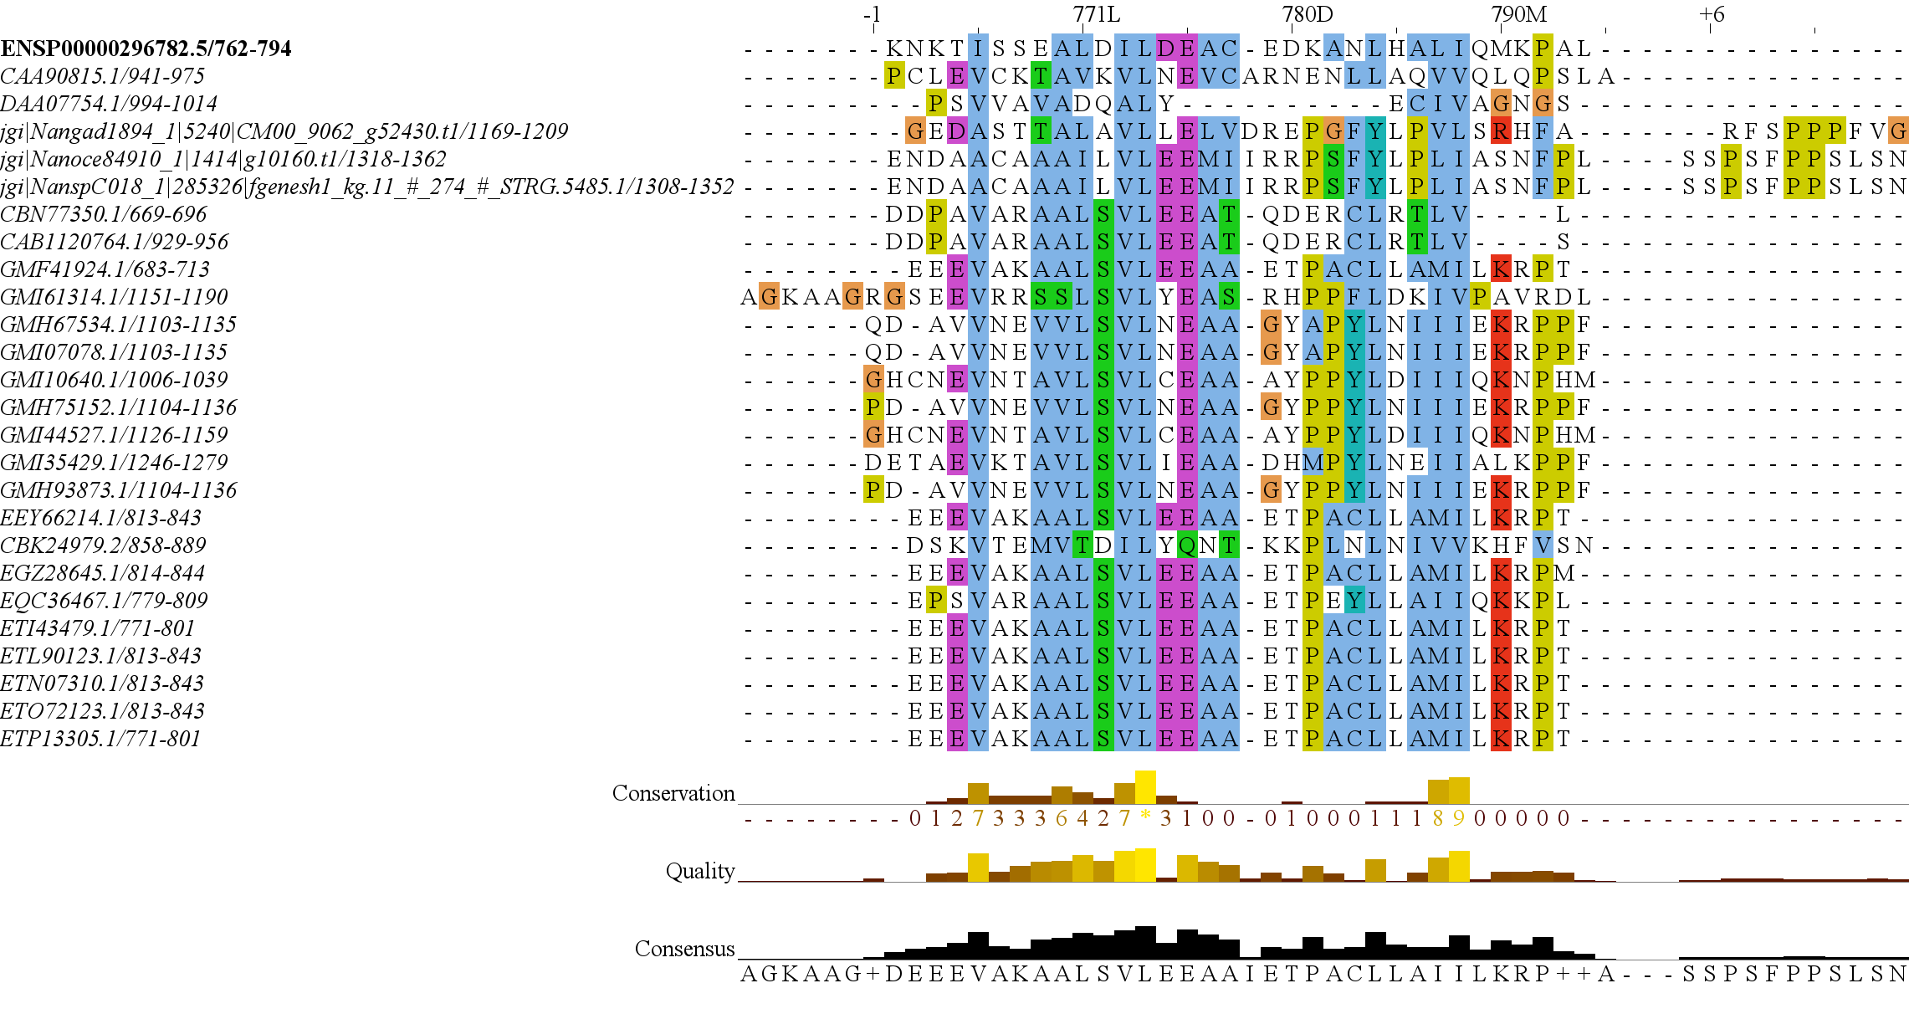
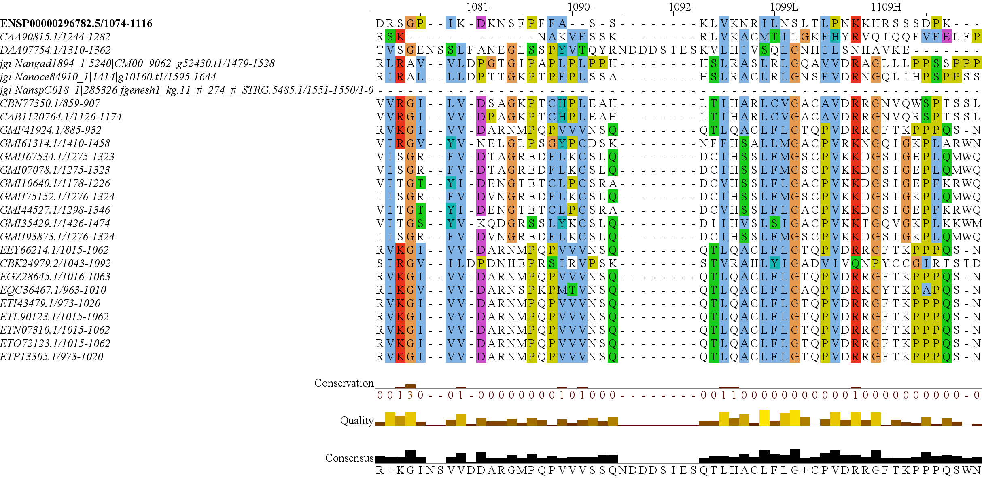
RICTOR N Domain
RICTOR M Domain
RICTOR RasG
RICTOR Phosphorylation Site

Slide 17
Granofilosa
Reticulofilosa
Filosa
Chlorarachnea
Cercozoa
Monadofilosa
Endomyxa, etc
Rhizaria
Chlorophyta Endosymbiosis
Retaria

Slide 18
Secondary Endosymbiosis Event
SAR
Amorphea
Archaeplastida
Ciliates
Ochrophyta
Alveolata
Apusomonada
Chlorophyta
Stramenopiles
Breviates
Streptophyta
Rhizaria
Rhodophyta
Opisthokonta
Amoebozoa
Discoba
Secondary Endosymbiosis Event
Metamonada
Euglena gracilis
Primary Endosymbiosis
Event
Excavata

Slide 19
TOR Complex 1
TOR Complex 2
RICTOR
RAPTOR
TOR
SIN1
TOR
LST8
LST8

Slide 20
Metamonada
Opisthokonta
Amoebozoa
Discoba
Rhizaria
Streptophyta
Alveolata
Stramenopila
Rhodophyta
Chlorophyta

